Slide 1

Reliance
T
Divine
Nature
Transcendentalism
Presentation
Transcendentalisms combined religion, philosophy, mysticism, and ethics.
Transcendentalists believed that all living things were bound together; humans were essentially good; insight was more powerful than experience as a source of knowledge.

Slide 2
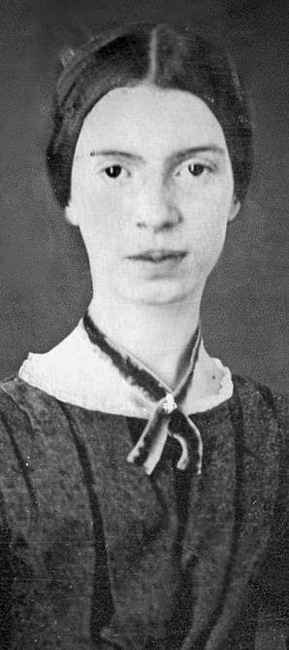
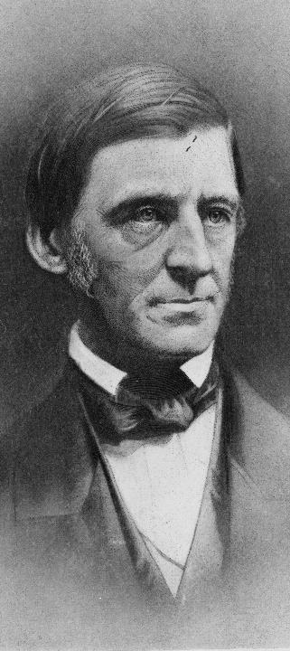
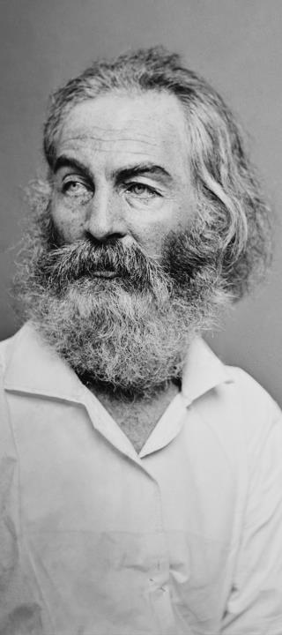
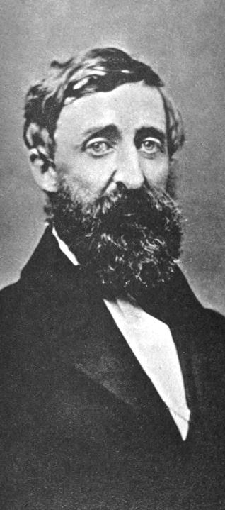
Emily Dickinson
Ralph
Waldo
Emerson
Walt
Whitman
Henry
David
Thoreau
“
”
“
”
“
”
“
”
One need not be a chamber to be haunted; One need not be a house; The brain has corridors surpassing Material place.
To be yourself in a world that is constantly trying to make you something else is the greatest accomplishment.
I too am not a bit tamed, I too am untranslatable, I sound my barbaric yawp over the roofs of the world.
Go confidently in the direction of your dreams. Live the life you have imagined.
Not our Part
Read More
Not our Part
Not our Part

Slide 3
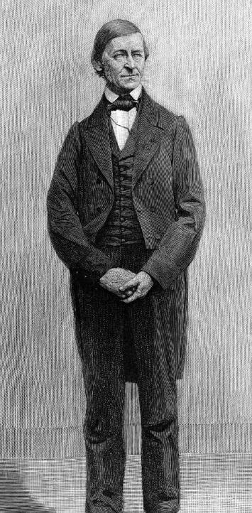




Content
Childhood Education
Emerson’s interaction with other people
Ralph
Waldo
Emerson
Themes of Writings
“
”
Sample texts
Self-trust is the first secret of success.
Emerson

Slide 4
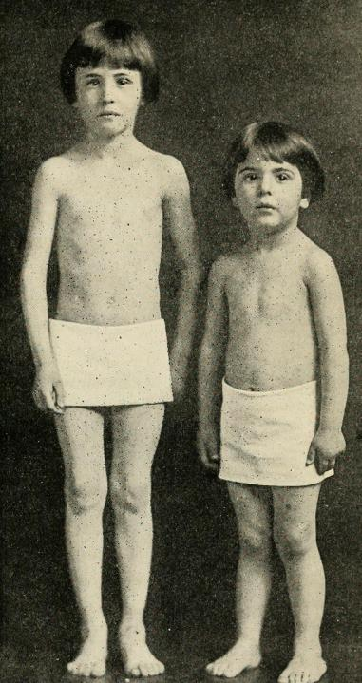
R
Ralph Waldo Emerson was born on May 25th 1803.
He was the fourth born, of 8 children, of the eight children only four made it into adulthood.
As a child, Emerson experienced selflessness and self-sacrifice through his disciplined and hardworking family.
Ralph’s Childhood
Emerson’s father suddenly died shortly before his eighth birthday.
This left Emerson's mother with a large family, and no means to support it.
In came Emerson's “eccentric” aunt, who would soon become Emerson's dominant influence.
Presented by Dennis Walsh

Slide 5
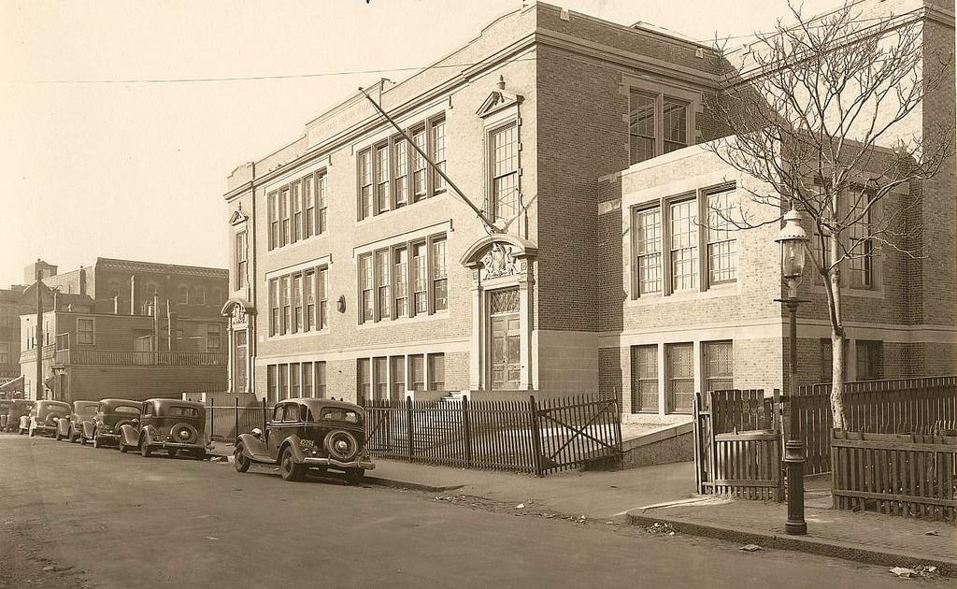
Emerson was taught grammar and reading when he was three.
He explained his lessons to his father at breakfast.
The home was very serious about recreation: reading history and poetry, practicing rhetoric and oratory.
When William (dad) died, Ruth’s (mom) number one priority was to put the men through good education, Harvard.
C
Aunt Mary taught him aphorisms he would take with him for life, such as “lift your aims” and “despise trifles”. She also taught him the dangers of prosperity.
Childhood
Education
Presented by Dennis Walsh

Slide 6

Emerson’s interaction with other people
E
Presented by Yunhao Gu
Emerson concurred with the German poet and philosopher Johann Wolfgang von Goethe.
Emerson borrowed Samuel Taylor Coleridge conception of “Reason,” which consists of acts of perception, insight, recognition, and cognition.
Emerson’s enduring reputation influence on Walt Whitman, Henry David Thoreau, and William James

Slide 7

Emerson’s interaction with other people
I
Presented by Yunhao Gu
Emerson’s contribution to American thought is his emphasis on non-conformity that had such a profound effect on Thoreau
Whitman used Emerson’s private correspondence to promote his own work and reveal Emerson as a successful and generous mentor.
Emily Dickinson doesn't exactly fall into the category of the Transcendentalists

Slide 8
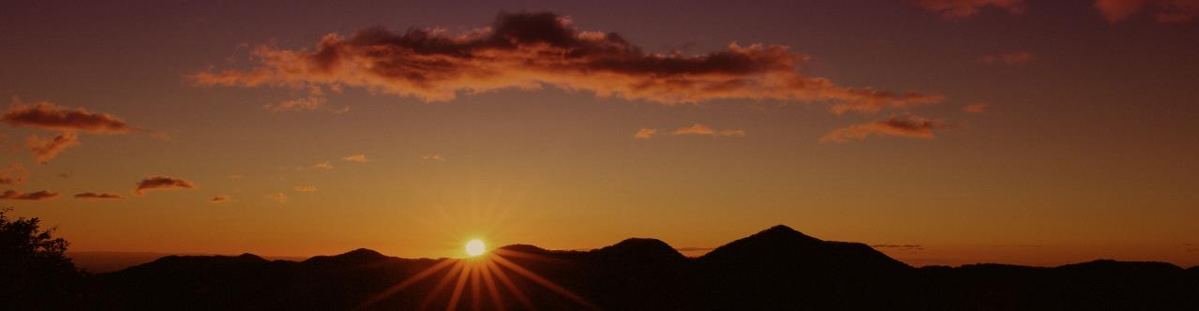




T
03
Theme of Writing
Presented By Zion
The Snowstorm
Nature
Concord Hymn
Self-Reliance
Emerson loves to write about nature and its beauty, and The Snowstorm is no exception….
In Emerson’s perspective, the society is the limitation of the individuals….
This is undeniably one of Emerson’s more famous works. …
Self-reliance on one's own powers and resources rather than those of others….
In the essay “Self-Reliance”, it is not about taking care of externals of life. What Ralph waldo Emerson wants the readers to know is that the essay is about the “State of one’s soul”. Emerson strongly advocates for trusting one’s inner promptings.
The lucid amount that Emerson states that a human should be a nonconformist as he embarks on life.

Slide 9

03
B
Born with a destiny implanted by God
Presented By Zion
Emerson believes that every person has an implanted destiny by god and every person will be unhappy until its fulfilled. Individualism society can impede this. So that's why it is important to go into solitude for a while so you can discern your path, but this does not mean you can do whatever you want in a hippy-dippy way or take the “easy way out”.

Slide 10
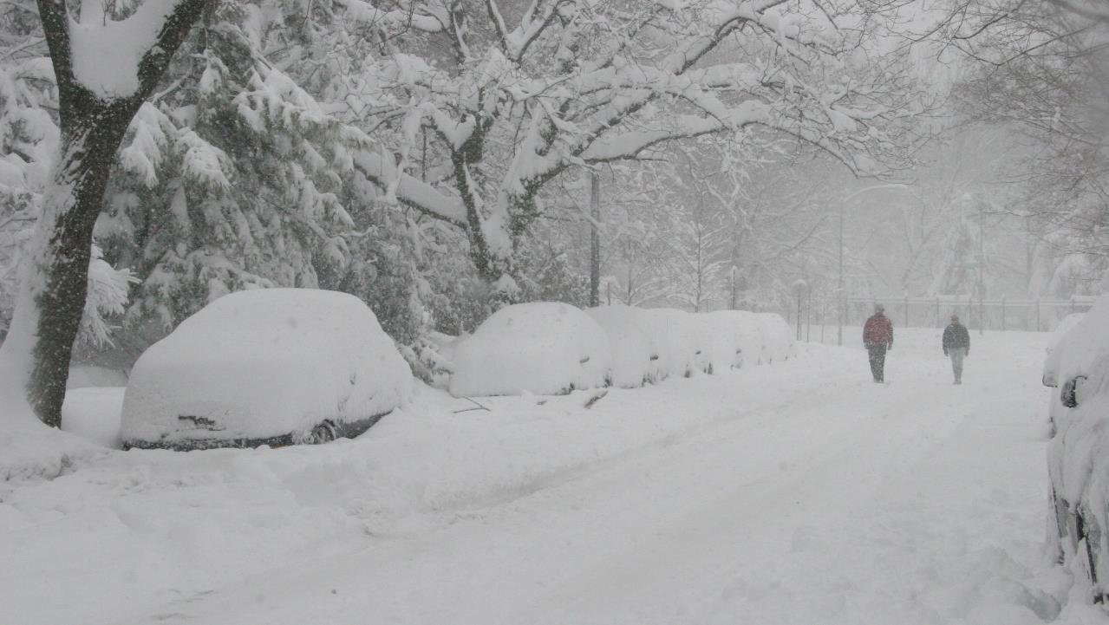
The purpose of The Snowstorm, is to explain the beauty of snowstorms. Emerson compares the snowstorm to a masonry, the snowstorm was rough and loud, like the artificer, yet when they both finished, they left behind something so beautiful and serine. Emerson thinks that the snowstorm is a positive thing; even though its rough through the storm, when its finished, there is a beautiful landscape left behind by such a violent force.
04
The Snowstorm
Presented by Jonathan
Emerson loves to write about nature and its beauty, and The Snowstorm is no exception.

Slide 11
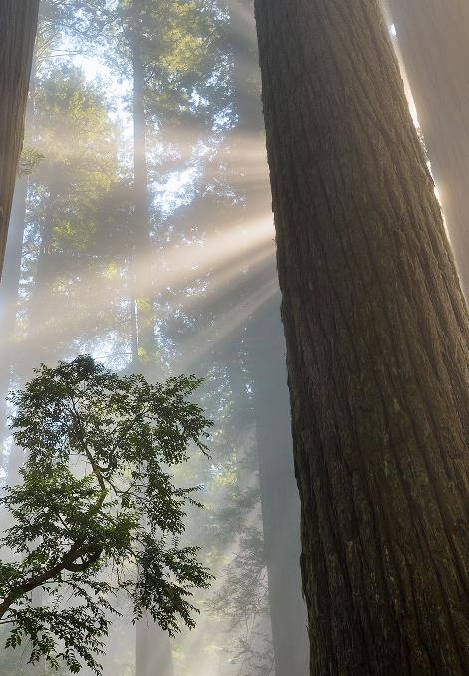
04
In Emerson’s perspective, the society is the limitation of the individuals.
Human beings, no matter from the time of Emerson or today, gather the knowledge from the society and the society only. In other words, people are filled with assumptions and conclusions from the culture or the community without experiencing them by themselves.
N
Nature
Presented by David Lai
Meanwhile, people are ignoring their relationship to the nature. To fully comprehend the truth, one must derive himself/herself from the society. Reason and faith, lacked in most people, would be only guides when they separate from the society and the nature surrounds them. We don’t need the help of religion; once focus on the nature, we would realize that the divine/God is everywhere.

Slide 12




Analysis on Nature
N
C
Presented By David Lai
Nature
Commodity
“
”
“
”
I become a transparent eye-ball; I am nothing; I see all; the currents of the Universal Being circulate through me; I am part or particle of God.
This (advantages of our senses owns to nature), of course, is a benefit which is temporary and mediate, not ultimate, like its service to the soul.
B
D
Beauty
Discipline
“
”
“
”
Thus the use of commodity, regarded by itself, is mean and squalid. But it is to the mind an education in the doctrine of Use, namely, that a thing is good only so far as it serves; that a conspiring of parts and efforts to the production of an end, is essential to any being.
To the attentive eye, each moment of the year has its own beauty, and in the same field, it beholds, every hour, a picture which was never seen before, and which shall never be seen again.

Slide 13
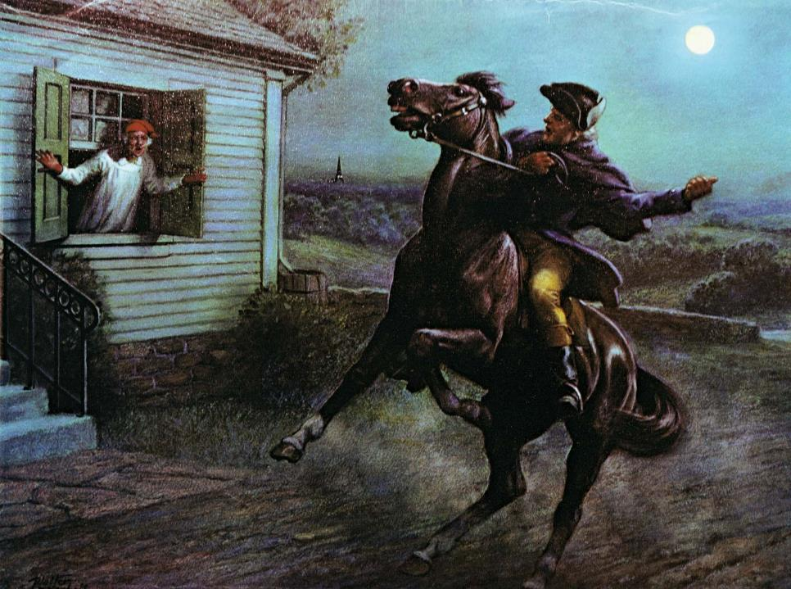
The Concord Hymn
Sung at the Completion of the Battle Monument, July 4, 1837
By the rude bridge that arched the flood,
Their flag to April’s breeze unfurled,
Here once the embattled farmers stood
And fired the shot heard round the world.
The foe long since in silence slept;
Alike the conqueror silent sleeps;
And Time the ruined bridge has swept
Down the dark stream which seaward creeps.
On this green bank, by this soft stream,
We set today a votive stone;
That memory may their deed redeem,
When, like our sires, our sons are gone.
Spirit, that made those heroes dare
To die, and leave their children free,
Bid Time and Nature gently spare
The shaft we raise to them and thee.
Presented by Nick Richard
This is undeniably one of Emerson’s more famous works. It was first released to the public on July 4th, 1837 to commemorate the battle of Lexington and Concord. The setting of the poem show the Soldiers on the bridge fearless to what comes. The flag to the April’s breeze Unfurled represent their own bravery and fearlessness to what is to come. The shot heard around the world in inarguably what this poem is famously known for. This shot was the first shot from the British attacking American soldiers. In later times the term was brought back for the Assassination Archduke Franz Ferdinand in 1914.
Summary

Slide 14

D
S
Definition
:
Self-Reliance
Self-Reliance is Emerson's complete interpretation of how so many actions committed by man is made by the actions of the past, other people, and their religion. Put simply, conformity is wrong. Emerson truly details how man only succeeds if he takes action for himself and realizing the greatness in him not in others.
Self-reliance on one's own powers and resources rather than those of others
Presented by Nick Richard
Emerson's Motto:
“Trust thyself”

Slide 15

Thank You for Watching.
Emerson
Transcendentalism

